Slide 1
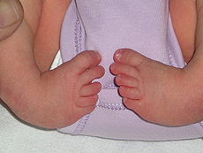
CONGENITAL TALIPES EQUINOVARUS

Slide 2
-Congenital talipes equinovarus (CTEV) is the medical term applied to the true clubfoot deformity in the newborn.
- If untreated, the foot would have no definition and would appear like a club and thus has its common name - clubfoot

Slide 3
-It is the most common foot defect known.
-Incidence- 1 in every 1,000 live births.
-Approximately 50% of cases of clubfoot are bilateral.
In most cases it is an isolated dysmelia
males > females by a ratio of 2:1
Postural TEV or Structural TEV.

Slide 4
CAUSES
-The causes of CTEV are unknown, but many factors may play a part.
Heredity is a factor, but the means of transmission are unknown. A baby born to a parent with clubfeet has a 1:10 chance of inheriting the disorder.
A combination of genetic and environmental factors in utero appear to be the cause of CTEV. It seems linked to arrested skeletal development during the ninth to tenth week of embryonic life.

Slide 5
The child may have other anomalies such as spina bifida or arthrogryposis, in which case the clubfeet are considered teratologic deformities.
Breech presentation.

Slide 6
CAUSES
Other theories propose neuromuscular dysfunction or muscle abnormality, primary germ plasm defect causing dysplasia of the ankle and that the other changes are secondary to this.
Brockman believes that the primary deformity is caused chiefly by congenital atresia of the articulation of the head of the talus and that other changes are secondary to this abnormality.

Slide 7
PATHOLOGY
The deformities affecting joints of the foot occur at three joints of the foot to varying degrees. They are
-Inversion at subtalar joint
-Adduction at talonavicular joint and
-equinus at ankle joint- a plantarflexed position

Slide 8
PATHOLOGY
The anatomical deformities in CTEV are : -equinus of the heel,
- varus and cavus of the midfoot, and
- adduction and supination of the forefoot.

Slide 9
There are changes in:
- bone,
- skin,
-tendons and
- ligaments.
The bones actually become distorted due to contractures of the soft tissues.

Slide 10
The bones chiefly deformed are the:
- talus,
-calcaneus,
- navicular and
-cuboid.
The ankle joint is severely affected with significant malrotation.

Slide 11
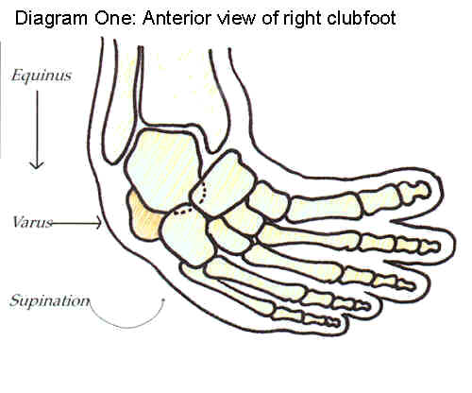

Slide 12
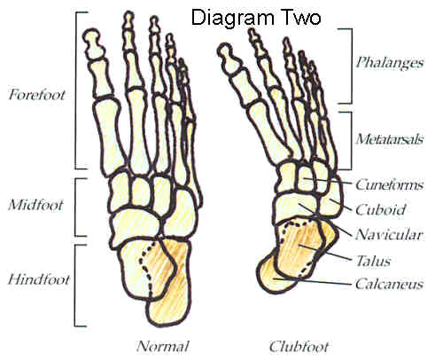

Slide 13
Differential diagnosis
Two other deformities that have similar features are:
Postural clubfoot - caused by the position of the fetus in utero. Often referred to as a packaging problem. This foot can be corrected manually by the examiner. It responds well and quickly to serial casting and rarely will relapse.
Metatarsus adductus (or varus) - is a deformity of the metatarsals only. The forefoot points to the midline of the body, or the "adductus" position. It can be corrected by manipulation also and responds to serial casting.

Slide 14
TREATMENT
The aim of treatment is to use the simplest means to obtain a plantigrade, painless and mobile foot which will not relapse to deformity during growth.
There are three stages in the treatment of CTEV:
- correction,
-maintaining the correction, and
-observation for several years to prevent recurrence.
Following treatment, the corrected position must be maintained for a long period of time to allow the bones to grow to a normal shape and allow fibrous tissues to mature.

Slide 15
CONSERVATIVE TREATMENT
Gentle manipulation and:
Adhesive strapping/splints e.g Dennis Brown bars
Plaster casts
Special boots.

Slide 16
SERIAL CASTING
- begins as soon as possible after birth.
-The casts are changed weekly at first, then biweekly and monthly.
-Over-correction is the aim, as the foot will drift back somewhat.

Slide 17
Correction is in sequence through gentle casting:
-first varus and adduction of the forefoot,
- then varus of the calcaneus and equinus of the forefoot and
- thirdly equinus of the ankle. (Crenshaw)
- Archilles tendon tenotomy – (Ponsetti)

Slide 18
-If serial casting successfully corrects the malformation, over a period of months, an orthotic will be prescribed and worn for many months afterwards to maintain the position.
- In young babies, a knee-ankle-foot orthotic (KAFO) is common.
- In older babies who will be learning to stand and walk an ankle-foot orthotic (AFO) is used.

Slide 19
- The surgeon will see the child in clinic on a regular basis to monitor the correction of the clubfoot.
???- Persistent forceful manipulation and prolonged casting can do more harm than good – technique!

Slide 20
PONSETI METHOD
- If correctly done, is successful in >95% of cases in correcting clubfeet using non- or minimal-surgical techniques.
Typical clubfoot cases usually require 5 casts over 4 weeks.
Atypical clubfeet and complex clubfeet may require a larger number of casts.
Approximately 80% of infants require an Achilles tenotomy performed in a clinic toward the end of the serial casting.

Slide 21
SURGICAL TREATMENT
-The indications - failure of reduction of the talonavicular and calcaneocuboid joints by manipulation and cast
-The operation itself is the open reduction of the talonavicular and calcaneocuboid joints by complete subtalar release and posteromedial releases.

Slide 22
The following is a list of the structures to be lengthened or sectioned:
a) muscles and tendons - Achilles (Z plasty), posterior tibial, adductor hallucis, flexor digitorum brevis and flexor digitorum longus, flexor digitorum brevis and abductor digiti quinti and quadratus planti
b) capsules and ligaments - talonavicular, subtalar, calcaneocuboid joint, ankle capsule, contracted ligaments on posterolateral aspect of ankle and subtalar joint and interosseous talocalcaneal ligament.

Slide 23
Resistant and recurrent clubfeet
-Occasionally, the deformity recurs.
-This can be distressing for all concerned.
considering the age and condition of each patient there are a few different operations
- posteromedial releases,
-osteotomies,
- tendon transfers or
- arthrodesis (fusion) of some of the bones.

Slide 24
COMPLICATIONS
-Recurrence
-smaller foot and calf on the affected side
- extra skin folds on the lateral ankle

